Slide 1
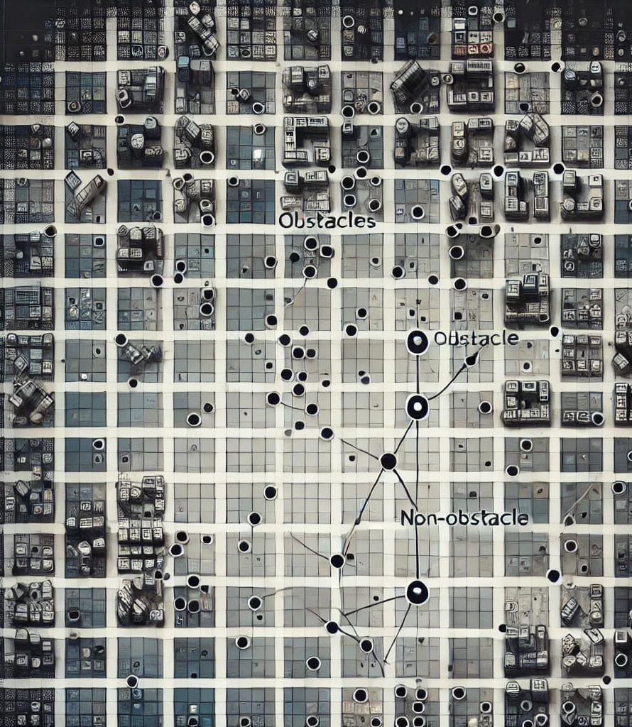
Visibility Learning

Slide 2
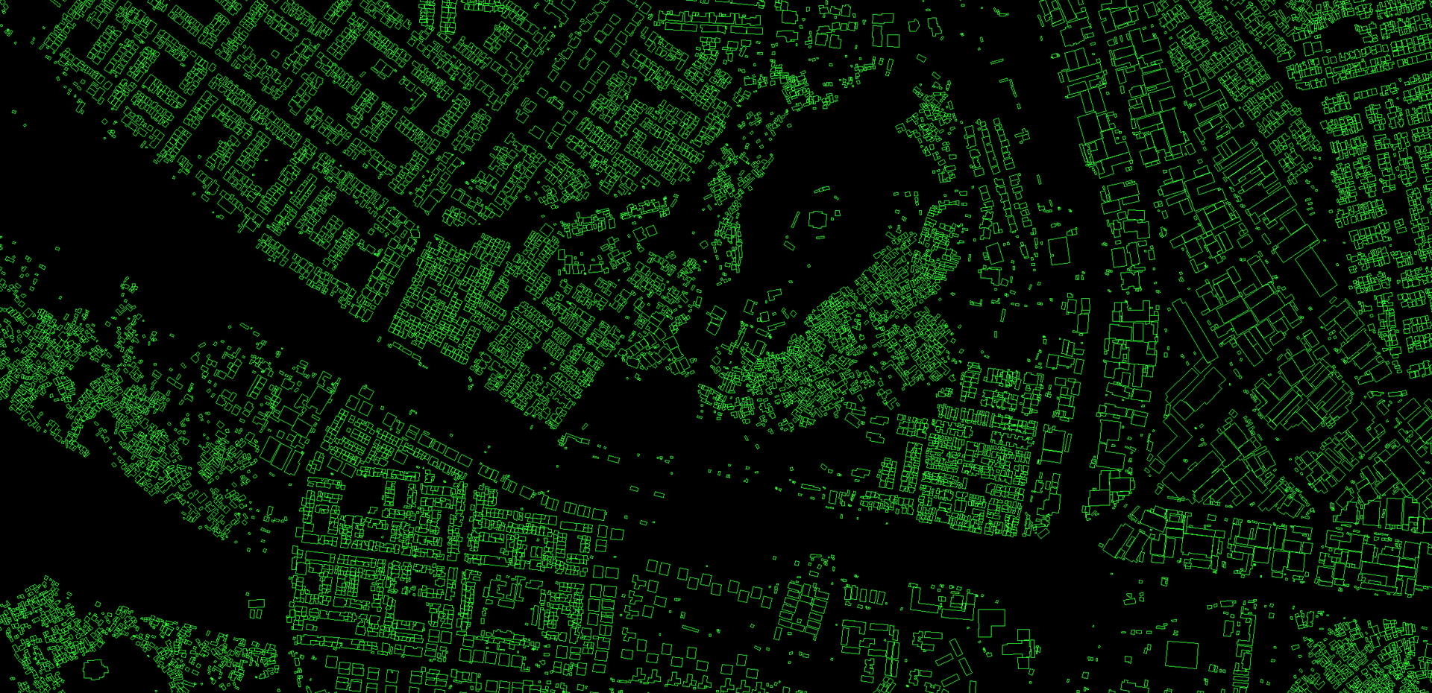
Open Buildings 2D A dataset of building footprints to support social good applications

Slide 3
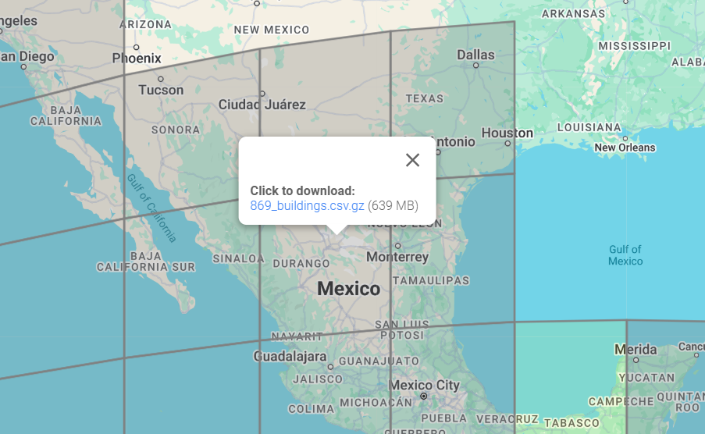
Open Buildings 2d
About 6.6 Million Polygon

Slide 4
Open Buildings 2d
Data Format: WKT
POLYGON ((vertex, vertex, ……………………))
MULTIPOLYGON (((vertex, ……), (vertex, ……………)))

Slide 5
Open Buildings 2d
Data Format: WKT
POLYGON ((vertex, vertex, ……………………))
MULTIPOLYGON (((vertex, ……), (vertex, ……………)))
Our Assumption:
To simplify scan conversion(encoding), we considered each polygon of a multipolygon to be a separate polygon

Slide 6
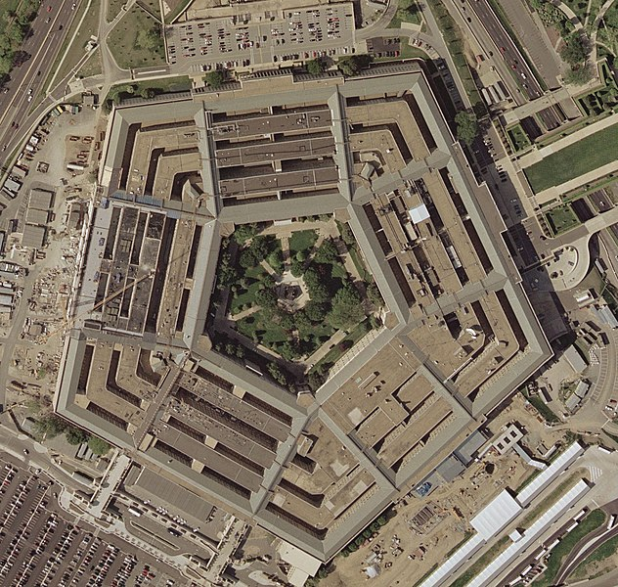
Open Buildings 2d
Data Format: WKT
POLYGON ((vertex, vertex, ……………………))
MULTIPOLYGON (((vertex, ……), (vertex, ……………)))
Our Assumption:
To simplify scan conversion(encoding), we considered each polygon of a multipolygon to be a separate polygon

Slide 7
Test set: 1758 Open Building 2D Scene (128*128 m²),
5000 pairs query points per scene
Training set: 2000 Synthetic Scene, 500 pairs query points per scene, 0-50% obs. coverage
Training set: 2000 Synthetic Scene, 500 pairs query points per scene, 0-50% obs. coverage
Metrics | Resolution 32x32
Loss | 0.6888
Accuracy | 0.8595
Precision | 0.8177
Recall | 0.9397
AUC | 0.9172
True Pos: | 4300418.0000
False Pos: | 958968.0000
True Neg: | 3254589.0000
False Neg: | 276025.0000
F1 Score: | 0.8744
Specificity: | 0.7724
Metrics | Resolution 64x64
Loss | 1.0120
Accuracy | 0.8037
Precision | 0.7582
Recall | 0.9148
AUC | 0.8575
True Pos: | 4186526.0000
False Pos: | 1335188.0000
True Neg: | 2878256.0000
False Neg: | 390030.0000
F1 Score: | 0.8292
Specificity: | 0.6831

Slide 8

Open Buildings 2d
About 6.6 Million Polygon
About 3.4 Million Polygon

Slide 9
Resolution: 64x64
Trained on: 12000 Synthetic Scene, 750 pairs query points per scene, 0-50% obs. coverage
Fine tuned on: 500 Open building 2D Scene, 500 pairs query points per scene
Sparse (0-33% obs. coverage) | Normal (33-67% obs. coverage) | Dense (67-100% obs. coverage)
335 | 160 | 5

Slide 10
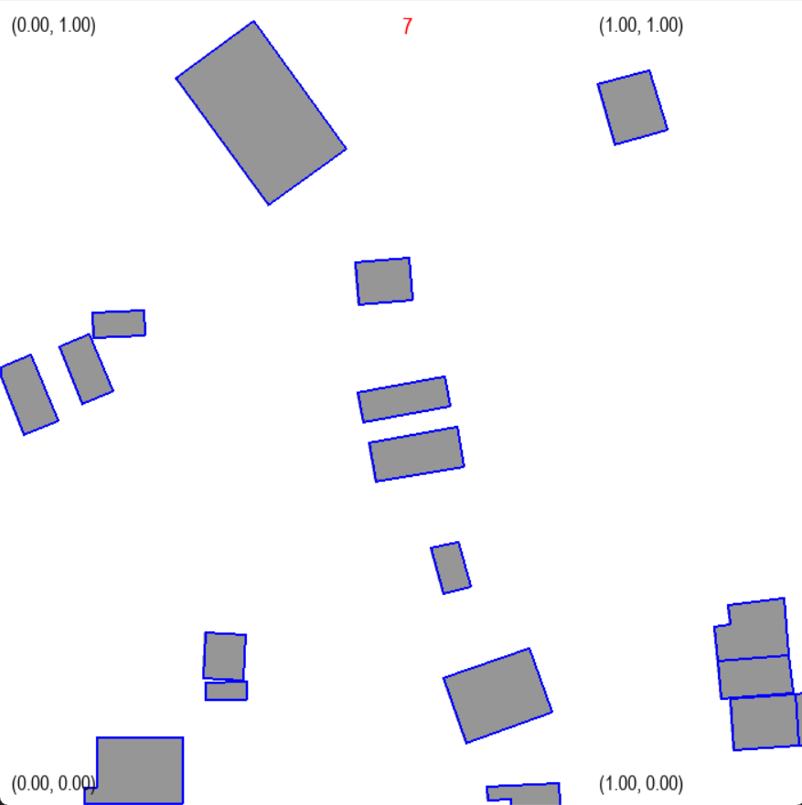
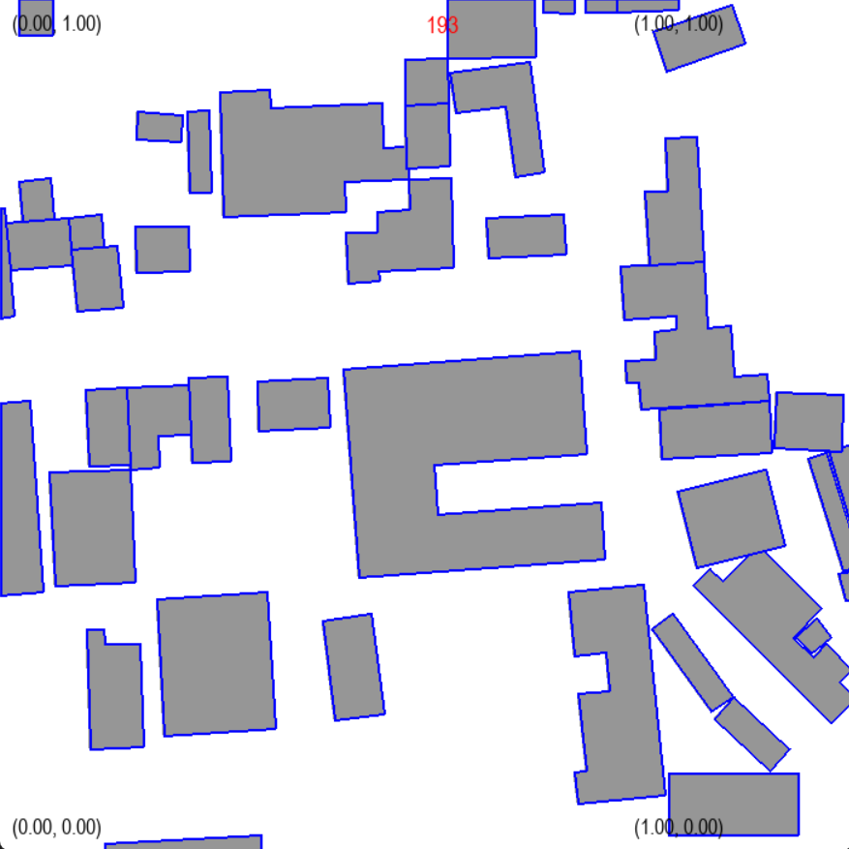
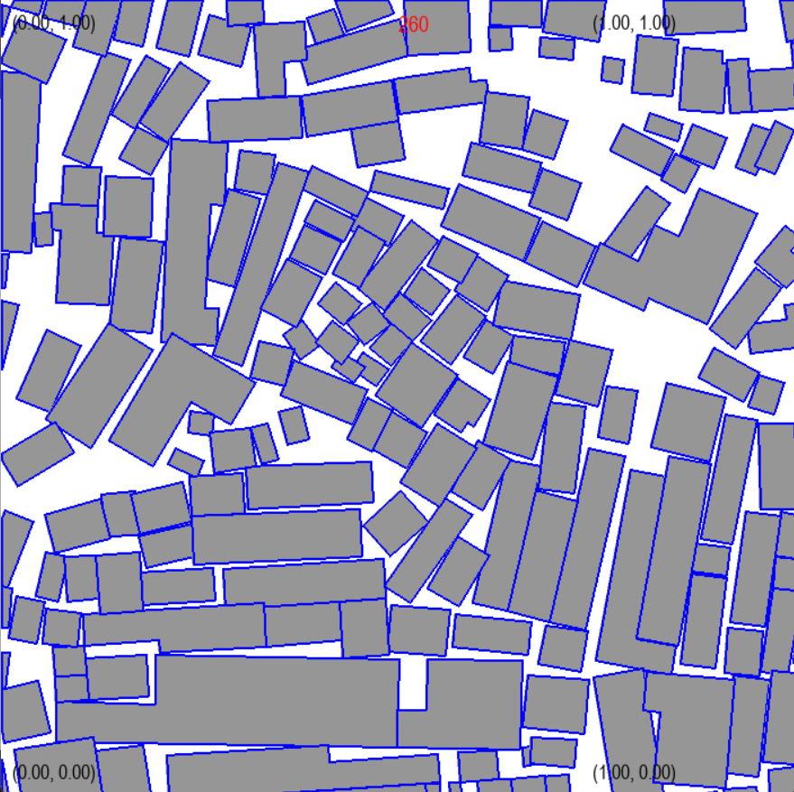
Sparse (0-33% obs. coverage)
Normal (33-67% obs. coverage)
Dense (67-100% obs. coverage)

Slide 11
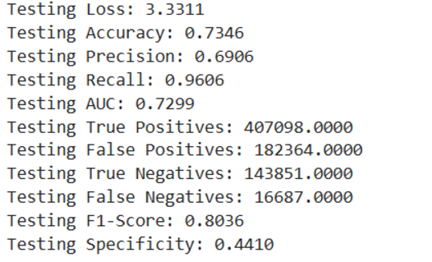
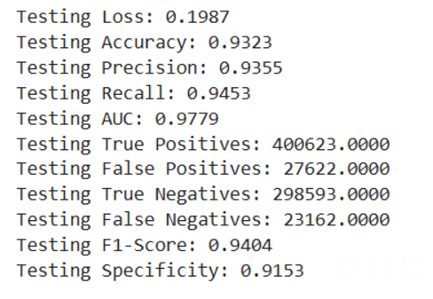
Sparse (0-33% obs. coverage)
Tested on: 1000 Open building 2D Scene, 750 pairs query points per scene
Without fine tuning
With fine tuning

Slide 12
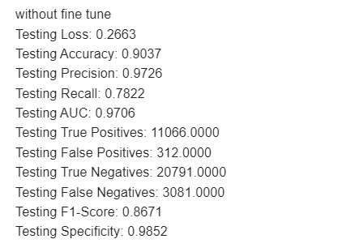
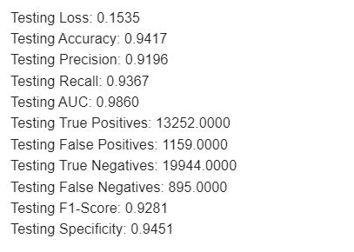
Normal (33-67% obs. coverage)
Tested on: 47 Open building 2D Scene, 750 pairs query points per scene
Without fine tuning
With fine tuning

Slide 13
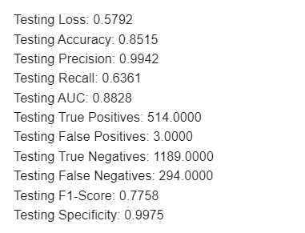
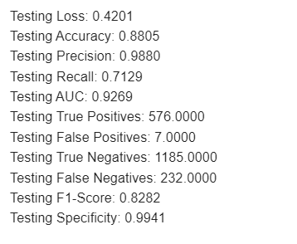
Dense (67-100% obs. coverage)
Tested on: 8 Open building 2D Scene, 250 pairs query points per scene
Without fine tuning
With fine tuning

Slide 14
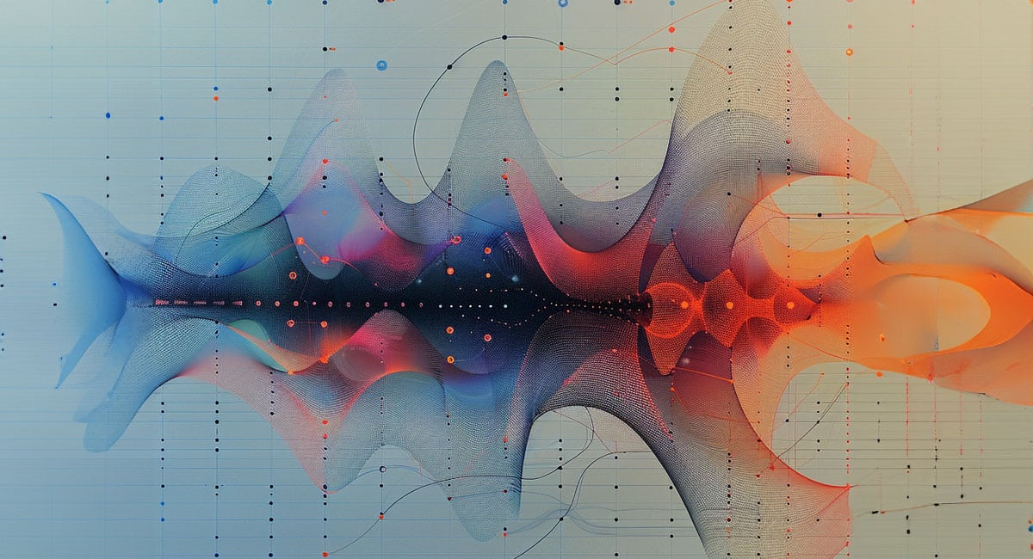
Experimental:
RNN based architecture

Slide 15
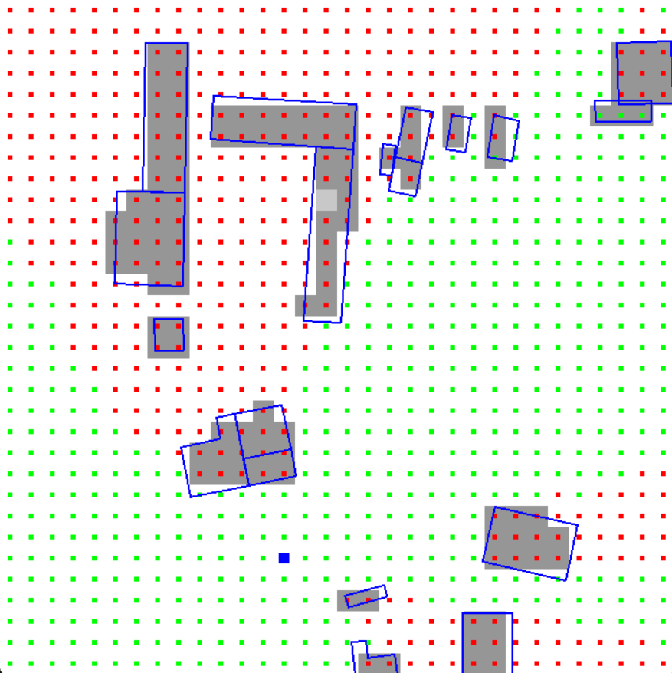
Experimental: RNN based architecture
Motivation:
In our current implementation, we predict visibility between some fixed cells.
Not between any two continuous points

Slide 16
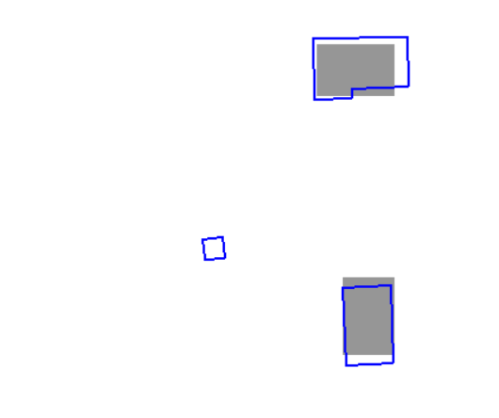
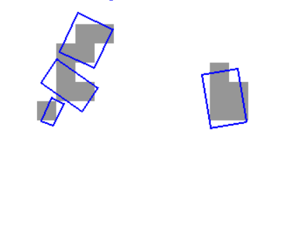
Experimental: RNN based architecture
Motivation:
Scan conversion loses accuracy
Doesn’t create embedding for obstacles smaller than cell
Incorrectly labels visibility in dataset (in our approach of dataset generation)

Slide 17
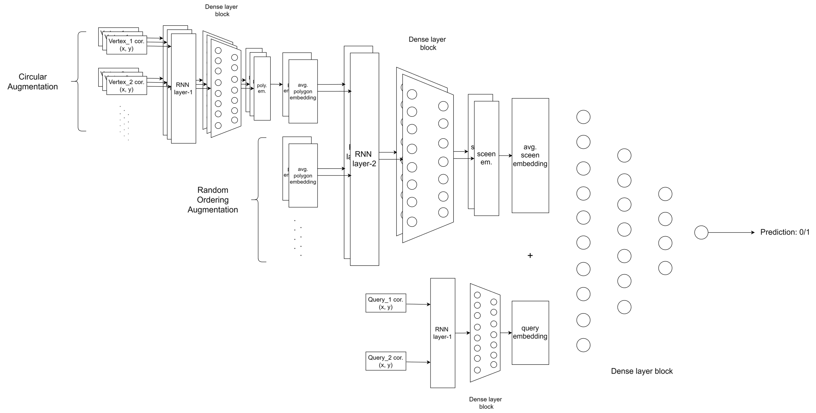
Experimental: RNN based architecture

